Slide 1

RFP Response:
Strategic Consulting for Digital Transformation of the IT Stack

Slide 2

TABLE OF CONTENTS
01
Executive summary
02
Capgemini’s Association
03
Incorporate learnings from recent IT Assessment
04
North Star Vision
05
Technical Proposal – Our response to RFP
06
Pre-requisites & Assumptions
07
Case studies
08
Team Structure & Governance

Slide 3
Statement of Purpose
Capgemini UK plc is pleased to submit this proposal in response to your RFP for Strategic Consulting on the Digital Transformation of IT stack. This submission reflects our clear intent to serve as your transformation partner—bringing deep telecom expertise, actionable insights, and a structured roadmap aligned with the business priorities.
Our approach is built on a comprehensive diagnosis of the current OSS/BSS ecosystem, a future-state architecture blueprint based on TM Forum standards, and a robust Total Cost of Ownership (TCO) and business case model. We aim to deliver measurable outcomes, improved customer experience, and enhanced operational efficiency.
We take full ownership of this engagement and are committed to delivering with accountability, transparency, and excellence across every phase—from discovery to vendor selection, implementation planning and support.
Our leadership is continuously committed as a strategic partner for the engagement …..

Slide 4




Executive Summary​
Our Understanding
We Will Achieve
Modernized Landscape Roadmap
Detailed Modernized Future State Blueprint (BSS/OS) across Mobile & Fixed Line Services mapped to industry best practices current state. Top prioritized Modernization Opportunities
Business looking at modernizing its OSS/BSS landscape in line with their vision & business priorities with strong emphasis on ROI, reduce TCO & reduced Time to Market
Comprehensive Diagnosis of the Current IT/Tech Ecosystem (OSS/BSS) to move towards Simplification, Standardization & Modernization
Identifying and address pain points, technical debt issues, apps and process gaps by aligning internal practices with telco industry standards to drive operational efficiencies & improvements.
End-to-end digitalization & modernization to transform the existing obsolete landscape to enable superior customer experiences & future-ready driven solutions.
Operational Optimization Opportunities
Improved Operating Model design for lower TCO, O&M costs, quick wins to achieve operational improvements & efficiencies across Tools & Technology landscape marked with migration & automation, mapped to industry benchmarks
Financial Ownership Model
A comprehensive investment and business case blueprint, leveraging a Total Cost of Ownership (TCO) model, outlines projected CapEx, OpEx, ROI, and prioritization of initiatives to support informed decision-making
Technology Partner Selection
Technology partner selection evaluation framework marked with business, technological & financial, other criteria with final recommendations & future-ready Gen AI driven solutions.

Slide 5
North Star Vision
Enabling shift from siloed, legacy, reactive technology landscape to modernized data driven intelligent Gen AI driven platform offering superior customer experience and business profitability.
Simplification
Rationalization
Modernization
Simplified BSS, OSS & other Applications landscape to enhance customer experience, scalability through Modernization. Transformation of duplicate, siloed and legacy applications is the key focus area
Rationalization & Process Standardization reduce complexities and technical debt unlocking true customer & financial values.
Data First Transformation approach towards Modular, Decoupled & Integrated IT stack across BSS & OSS landscape driven by Gen AI Philosophy
1
2
3
4
5
Consolidating legacy systems into simple modular platforms to reduce maintenance costs, licensing overheads by removing duplication
Unified Cloud native BSS/OSS modular platforms supporting both mobile & fixed line across CRM, Provisioning, Inventory Mgmt. etc.
Product/Service locked flexible HW/SW design driving highly scalable inward-looking model to improve ROI on G.fast, IMS etc.
Transition towards Open API architecture design in line with industry standards to enable faster time to market & superior monetization opportunity (Movilcash, Automation etc.)
AI driven phased BSS/OSS modernization program in line with Panama’s telecom regulations in line with market requirements, investment optimization

Slide 6
Methodology & Assessment Framework
Methodology is centered towards finalization of key drivers which will help to consolidate, simplify & modernize Apps landscape across Business Lines. Modernization assessment will be based 4- point framework guiding towards Apps Retirals, Retention, Replacement or Re-Engineering to improve CX, reduce technical debt & overall costs.
Discovery
Applications Evaluation Drivers
Assessment Framework
( will drive the Transformation Outcomes)
Framework driven Modernization Assessment
Business Value
Tech Quotient
Performance
Functionality
Reliability
Risks
Criticality
Cross Functionality
Platform
Cloud Adaptability
EOL
Security
Integration & Tech Debt
GenAI Adaptability
Retire
(Low Business Criticality + Low Business Process Coverage + Negative Usage Trend + Low Application Uniqueness +) vs. TCO vs. Risk)
Retain
(High Business Criticality + High Application Performance + High Application Maturity) vs. TCO vs. Risk)
Minimal Changes, Superior applications, High Business value
Sunset, Decommission
Baseline
Current BSS/OSS landscape
Financial Returns
Maturity
Replace
(High Business Criticality + Low Application Performance + Low Application Maturity) vs. TCO vs. Risk)
Re-Engineer
(High Business Criticality + Low Business Process Coverage + High Application Performance + Low Application Maturity) vs. TCO vs. Risk
Data Collection & Monitoring
License costs
Infrastructure costs
Support and maintenance costs
Payback period / ROI
Capacity
Ease of Use
Legacy/COTS
Industry Adaptability
Vision Fitment
Ease of Customization
Benchmark, Find Best-fit solutions
Upgrades, Enhancements, Migrations
Current Application Design
Comparative Analysis along with Application quality score is used to map application to decide application disposition and future state

Slide 7
Overview of onshore-offshore collaboration for efficient program delivery​
Onshore Team
Offshore Team
Discover
Conducting workshops roles, gathering documents and other artefacts in line with pre-agreed timelines and milestone schedule
Engaging stakeholders effectively across language barriers
Ensuring strategic governance across the program
Create Stakeholder list
Prepare templates
Reviews, daily stand-up meeting & cadences with Onshore
Agree and approve the deliverables
Assist the market scan of vendors with location specific view
Review the draft RFP and
Approve the proposed TCO model and Business case proposed
Create TM based future assessment framework
Market scan of OSS/BSS vendors and evaluation and documentation of pre-qualified vendors
Drafting of the RFP technical sections
Detailed TCO model for proposed solutions
Comparative analysis of as-is OpEx vs. projected OpEx
Evaluate and Create
Recommend
Assist Vendor management to ensure round the clock support
Review and assist the vendor evaluation and recommendations
Review of SLAs, warranties, and penalties for non-performance
Definition of high-level implementation plan & Identification of risks and mitigation strategies
Support
Support in negotiations for licensing, hosting, and managed services.
Review of high-level implementation plan
Management of vendor Q&A and clarifications
Coordination of technical defenses and proof-of-concept
Recommendations for sequencing replacements / upgrades
How do we collaborate
Time Zone Synchronization​
Divide & Conquer Approach​
Governance Cadence​
Knowledge Transfer & Documentation​
Ensure 3–4 hour daily overlap (e.g., 2–6 PM IST with EST mornings) for real-time collaboration.
Onshore leads workshops and stakeholder meetings; offshore executes analysis, documentation, and technical builds concurrently.​
Scheduled meetings include Monday planning calls, daily 15-minute syncs, and Friday deliverable reviews.
Weekly documentation handoffs, cross-team peer reviews, and offshore upskilling led by onshore design authority.​

Slide 8
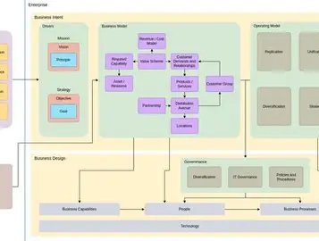


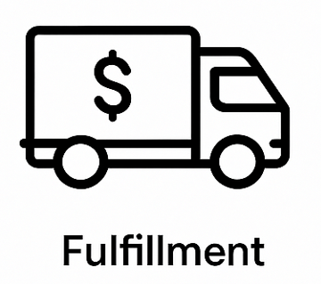
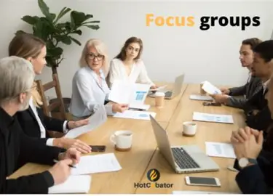
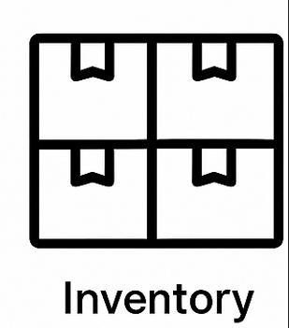
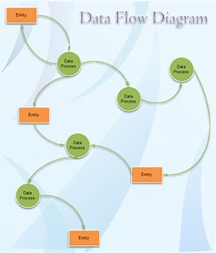

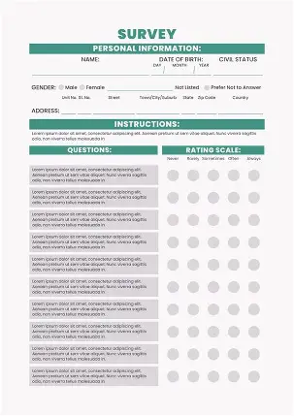
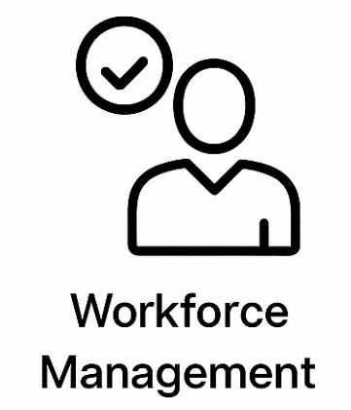

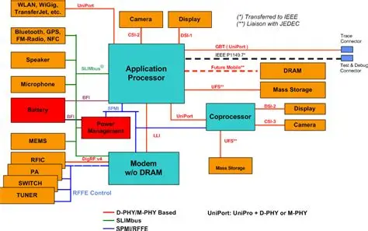
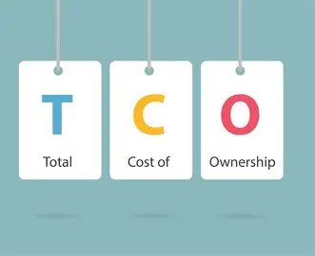
We propose to start Discovery where we assess your existing ecosystem​
Discover
Evaluate & Create
Recommend
Support
Understand and document the Business processes across all products
Understand the OSS/BSS ecosystem
Architectural Assessment
Financial Assessment
As is Processes documentation
(mapped to L3)
Understand existing IT ecosystem
Kick off discussion with key stakeholders
CRM
Billing
Activities
Focus interviews on investment rationale and scope for proposed solutions and transformation scenarios
CPQ
Provisioning
Architectural diagrams
Mediation
WFM
Data flow diagrams
Issue questionnaire to understand the existing spend (CapEx
and OpEx), including license, infrastructure and
support & maintenance costs
Product catalog
ESB
Analyze existing BSS and OSS costs to build as-is
TCO model and identify high level cost levers
based on initial assessment
Interfaces
As-is Business process flows for each Product Line
High level static diagram of architecture
High level architectural and integration diagrams
As-Is TCO Assessment
Deliverable will cover
Current State Assessment Report

Slide 9
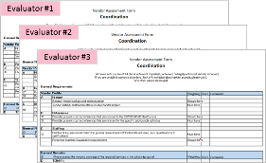
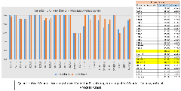
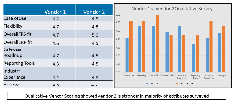
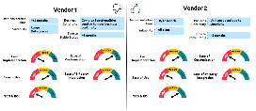
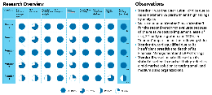
Our vendor market analysis & pre-selection approach
Vendor evaluation will be structured around defined categories, with subgroup criteria, grading, scoring and Future State collaborators.
Discover
Evaluate & Create
Recommend
Support
Supplier scorecards dimensions
Illustrative example Vendor Evaluation
Financial
Economical Status
Financial Status
Credit Score
Liabilities
INDIVIDUAL VENDOR EVALUATIONS
AGGREGATED QUANTITATIVE EVALUATIONS
Technical
Technical Know How
Provisioning
Data Integration
Modularity of Solution
Functional
Change Management
Scalability
Digital Strategy
Operational
Cost, Innovation & R&D
Product Reliability
Quality
Management & Organization
Flexibility
Customer
Amount Of Past Business
& Strategic Fit
Customer Relationship
Packaging Abilities
Performance History
Warranties & Claims
QUALITATIVE VENDOR COMPARISON
SECONDARY RESEARCH OVERVIEW
Continuous Learning
Cultural Congruence
ITC Systems
Labor Relations
Personnel Training
Safety Awareness
Procedures
Corporate Social Responsibility
Environmental
Competency
Environmental Policies
Design For
Environment
Pollution Reduction
Market analysis and vendor evaluation will drive a focused shortlist for high-impact RFP execution

Slide 10


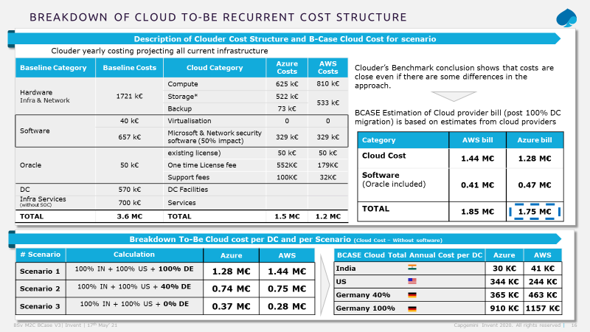
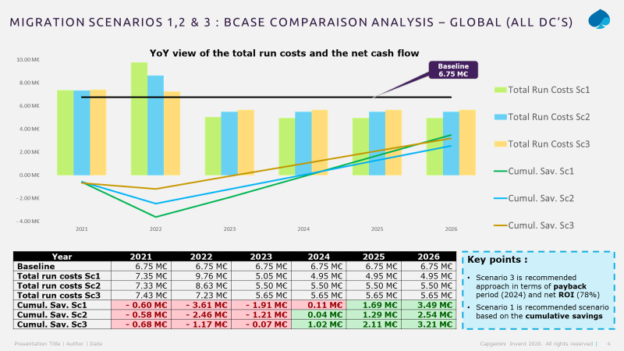
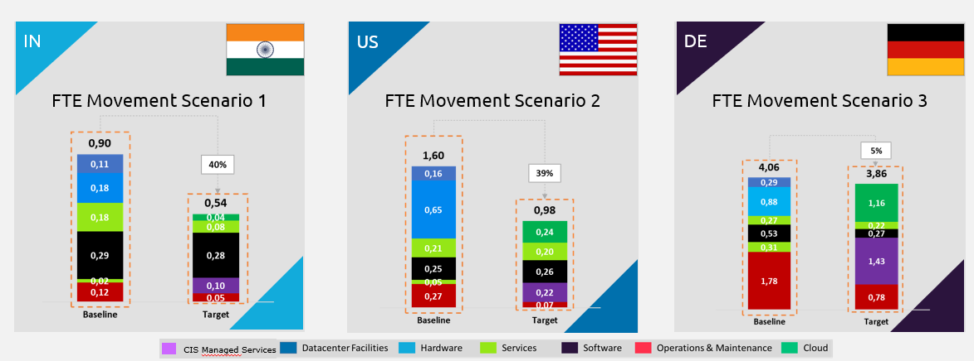
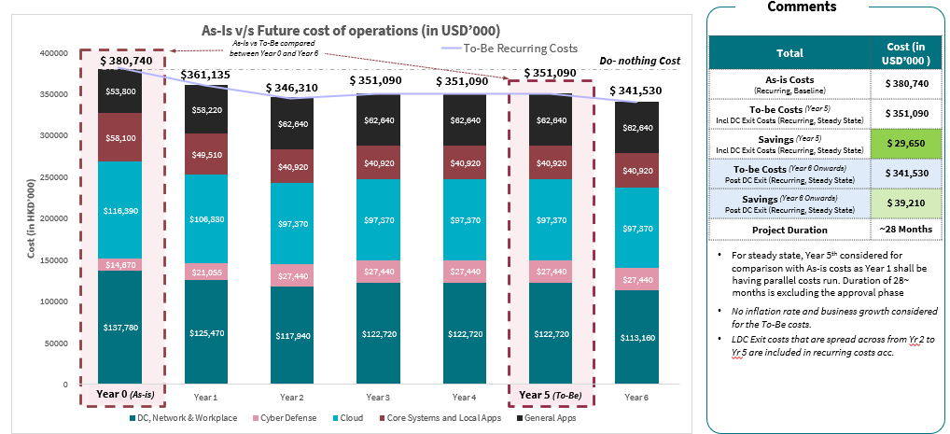
A structured methodology that identifies IT TCO and drives potential opportunities through business case
Discover
Evaluate & Create
Recommend
Support
We will work in collaboration to build a comprehensive view of current state costs, investments required for proposed transformations and target state costs along with potential benefits
Target State TCO & Transformation Scenario Analysis
Business Case Presentation
Target State Costs-Benefits Analysis
Transformation Cost Analysis
Business Case Presentation
Analyze the target state cost inputs to build the To-be TCO model (CapEx and OpEx)
Estimate Target state technology costs (license, infrastructure and support & maintenance) to build To-be TCO model for identified initiatives
Provide insights on indicative potential benefits by initiative based on industry standard benchmarks & Capgemini experience
Evaluate the resource effort required for implementation considering customization requirements, integration with existing systems, change management and trainings
Calculate transformation costs (CapEx) based on estimated efforts and resources
Prepare financial business case (ROI, payback period) for proposed solutions and transformation scenarios based on cost estimates, potential benefits and investments
Align business case with financial governance requirements
Validate business case with key stakeholders and propose investment decisions based on business case findings
Key activities
Transformation Scenario Analysis
Perform financial analysis for transformation scenarios (e.g. reuse vs build vs buy, standard vs customization) by comparing total costs and benefits of each option over the lifecycle of solution
Iteratively build on the financial analysis model for conservative, realistic and aggressive scenarios, and conduct periodic review with +Móvil key stakeholders
Recommend the most optimum solution and scenario for identified initiatives
Work Products
To-Be TCO and Transformation Cost Assessment
Potential Benefits Driver Assessment
Transformation Scenario Analysis
YoY Financial Analysis with ROI and Payback Period

Slide 11





We will utilize a robust IT cost modelling framework to quantify costs and benefits that support data-driven decisions through business case
Discover
Evaluate & Create
Recommend
Support
Project Investment
Implementation Costs
Training Costs
Dual Run Costs
Other One-time Costs
As-Is Operations (People Costs) + AI Costs
Operations (Productivity Improvement)
Business Ops
+Móvil’s TCO and Business Case Building Blocks
To-Be Operations (People Costs) + AI Costs
As-Is License Costs
License Cost Reduction
Process Efficiency Benefits
Operations (Productivity Improvement)
As-Is Infrastructure Costs
To-Be License Costs
Total Cost Benefits
Infrastructure Cost Reduction
IT
IT Operations (People Costs) + AI Costs
To-Be Infrastructure Costs
IT Operations (People Cost Reduction)
IT TCO Benefits
License Cost Reduction
To-Be IT Operations (People Costs) + AI Costs
Infrastructure Cost Reduction
IT Operations (IT People Cost Reduction)
1
+Móvil’s Current State Cost
(Baseline Costs)
2
Estimated Transformation Cost
3
Target State Cost & Benefit Estimation
4
Summary of Cost Benefits
Informed Decision Making
Prioritization of Initiatives
Alignment with Business Goals
Performance Tracking & ROI Realization
Improved Governance & Accountability
Key Benefits
Data-driven decisions by comparing complete OSS/BSS infra and operation costs and expected returns
Ranking & prioritization of initiatives based on ROI, strategic alignment and feasibility
Clear alignment between IT transformation initiatives and defined business objectives
Baseline for measuring transformation benefits and tracking ROI over time
Strong financial governance by aligning IT investments with strategic business priorities

Slide 12
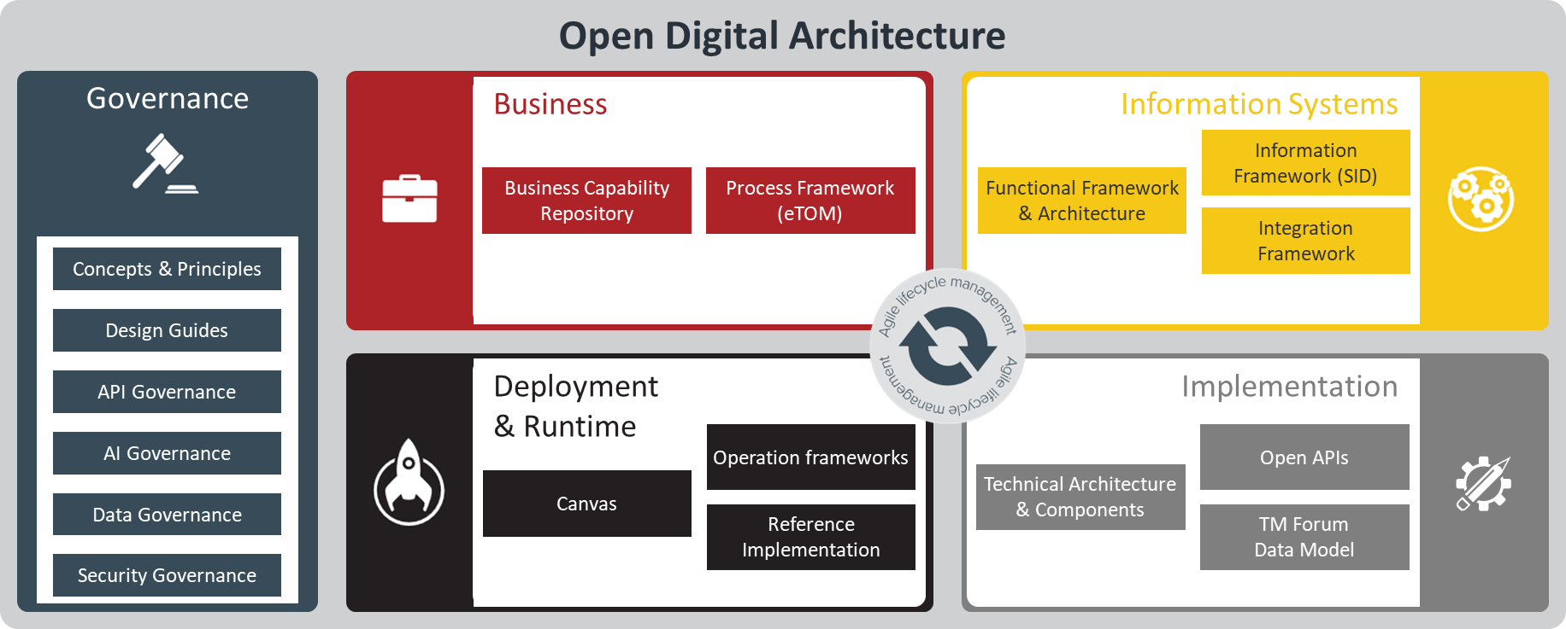
…..and enabled by leveraging TM forum’s ODA components
The transformation roadmap will be defined based on ODA architecture and then refined functional and technical requirements will be drafted
Discover
Evaluate & Create
Recommend
Support
ODA is a complete enterprise architecture blueprint for open digital platforms, replacing traditional operational and business support systems
Comprises standardized, reusable, cloud native software components organized into loosely coupled domains

Slide 13
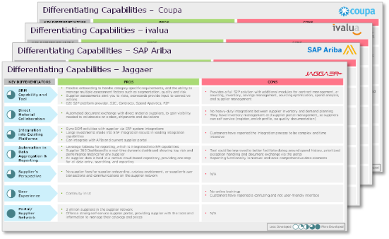
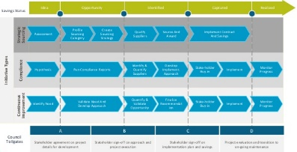
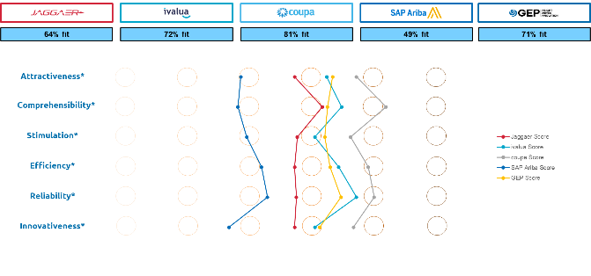
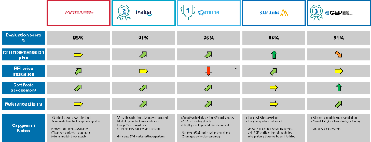
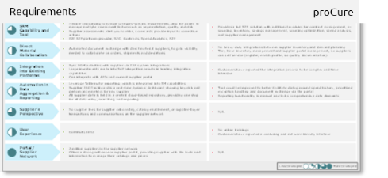
Structured support for RFP execution & vendor assessment
A structured, multi-phase approach to RFP execution and vendor assessment—covering drafting, engagement, validation, and decision-making to ensure strategic alignment and transparency
Discover
Evaluate & Create
Recommend
Support
Technical RFP Drafting
Vendor Interaction Management
Technical Validation & PoC
Decision Matrix
With a clear understanding of provider differentiators, we've developed an RFI framework to capture precise, requirement-based responses.
Define objectives, architecture, and evaluation criteria; initiate RFP process with shortlisted vendors, leveraging Gen AI to assist in RFP generation
Structured engagement model ensures consistent communication, alignment, and responsiveness across shortlisted vendors
Manage vendor queries, refine evaluation criteria, and communication—enhanced through Gen AI-driven communication management
Hands-on validation through PoC and technical scoring ensures solution feasibility and alignment your requirements
Conduct workshops to validate feasibility, assess performance, and refine proposals—enhanced by Gen AI to streamline and strengthen the evaluation process
A weighted decision matrix enables objective vendor selection based on strategic fit, technical merit, and business value.
Score vendors on Functional, technical, Technological, Financial, and TCO fit; finalize vendor supported by Gen AI for parameter-based evaluation and final recommendations

Slide 14




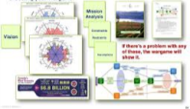


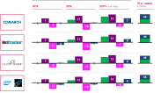


Contracting support and high-level implementation planning
Establishing a negotiation strategy outline, objectives and contract amendments for negotiation of the contract to align vendor performance to the digital transformation objectives and planned business outcomes.
Discover
Evaluate & Create
Recommend
Support
PREPARE
INITIAL DRAFT & VENDOR REVIEW
SUPPORT NEGOTIATION & REVIEW
FINALISATION & EXECUTION
Define objectives clarifying the business goals, scope of services and expected outcomes
Assess potential risks – legal, financial, security, Business continuity
Collect requirements for compliance, data protection needs, SLAs
Review Key Clauses including
  Service Level Agreements
  Data protection & privacy
  Confidentiality & NDA
  Termination & exit criteria
  Vendor feedback / concerns
Support development of the negotiation strategy, challenge and share best practice
Security provisions (high level data encryption standards, residency, access controls) ,Legal & Regulatory T&Cs
Review key contract clauses, terms and SLA’s intended to improve the vendor’s business &reducing the risks
Secure mutual agreement – Approvals & Sign Offs
Negotiation Strategy
Negotiation Briefs
War Gaming
Pricing Simulation
Pricing Benchmarking (as of RFI)
Business Case Impact
Telecom Business /Operations KPI Catalogue

Slide 15
Statement on tax, audit, legal & regulatory services
Discover
Evaluate & Create
Recommend
Support
Capgemini has no permit to deliver accounting, tax, audit, legal or regulatory services (‘legal advice’), that are strictly regulated and out of scope of Capgemini’s consulting perimeter. Any high-level assessment ran by Capgemini Invent, as well as any material created by Capgemini as part of its services, do not, and are not intended to, constitute legal advice or other professional advice or an opinion of any kind. Capgemini does not warrant or guarantee the quality, accuracy or completeness of such high-level assessment and materials.
Capgemini’s assessment and materials must hence be reviewed, finalized and validated by accredited or certified organizations who are authorized to provide such accounting, tax, audit, legal or regulatory services (out of scope of this proposal and to be purchased by you separately from any such accredited or certified organizations)

Slide 16

Leading European CSP
Strategic IT Transformation & Landscape Modernization
Enabling future-ready operations through modular platforms, partner-driven innovation, and a business-aligned transformation roadmap.
Purpose of Transformation
The existing IT stack lacked agility, modularity, and integration, limiting the organization’s ability to scale, collaborate with partners, and deliver next-generation digital services. This created operational inefficiencies and hindered customer experience
Solution Proposed :
A transformation roadmap was co-developed to modernize the IT stack, aligning architecture with business growth objectives. The solution focused on building a scalable, modular, and API-driven IT landscape to enhance operational efficiency and elevate customer experience
Our Approach
Assess Current State: Reviewed IT maturity, architecture, operating model, and partner landscape
Strategic Deep Dives: Focused on B2B enablement, sourcing, and architecture vision
Blueprint Design: Defined future-state architecture aligned with business goals
Transformation Planning: Mapped initiatives, benefits, and risks.
Operating Model: Proposed sourcing strategy, agility framework, and governance
Key Deliverables
IT Strategy Plan: Vision, roadmap, and transformation priorities co-developed with client
Architecture Blueprint: Modular, cloud-native design enabling scalable B2B services.
Transformation Roadmap: Phased initiatives aligned with KPIs and business outcomes.
Alignment
Ensured strategic coherence by integrating IT architecture with business objectives.
Scalability
Enabled long-term growth through modular, cloud-native platforms
BENEFITS DELIVERED
Optimization
Achieved operational efficiency through automation and streamlined sourcing

Slide 17

Media & Entertainment Global
Vendor Selection for Supplier Visibility Capabilities
N-tier supplier visibility and third-party risk management for regulatory readiness
Problem statement
Client’s SRM capabilities were limited to tier-1 suppliers, necessitating enhanced visibility and risk management across N-tier suppliers to meet regulatory requirements.
Objective of the solution
Define a target solution and select a suitable software vendor, while designing a comprehensive third-party risk management framework to enhance supplier transparency and regulatory readiness.
Our Approach
Discovery
    Aligned on vision and goal setting
    Assess current state
    Review solution provider landscape
Target State Definitions & Vendor Evaluation
    Develop a list of requirements
    Prioritize use cases / proof points
    Develop RFP documentation and vendor evaluation criteria
    Assist in demo scenarios and vendor evaluation
Recommendation & Plan
    Support final vendor evaluation and recommendation
    Support implementation planning and estimation efforts
    Support development of third-party risk framework
Key Deliverables
An iterative third-party risk framework
A process and solution implementation roadmap
A governed list of vendors to enable the global merchandise product business
Continuous screening and monitoring of suppliers down to N-tier, to help verify compliance
Transparency
Full visibility into N-tier suppliers for better compliance
Control
Structured framework and roadmap for risk management
BENEFITS DELIVERED
Enablement
Governed vendor list to support global merchandise operations

Slide 18
About Capgemini
As the digital innovation, design and transformation brand of the Capgemini Group, Capgemini Invent enables CxOs to envision and shape the future of their businesses. Located in over 30 studios and more than 60 offices around the world, it comprises a 13,000 strong team of strategists, data scientists, product and experience designers, brand experts and technologists who develop new digital services, products, experiences and business models for sustainable growth.
Capgemini Invent is an integral part of Capgemini, a global business and technology transformation partner, helping organizations to accelerate their dual transition to a digital and sustainable world, while creating tangible impact for enterprises and society. It is a responsible and diverse group of 340,000 team members in more than 50 countries. With its strong over 55-year heritage, Capgemini is trusted by its clients to unlock the value of technology to address the entire breadth of their business needs. It delivers end-to-end services and solutions leveraging strengths from strategy and design to engineering, all fueled by its market leading capabilities in AI, cloud and data, combined with its deep industry expertise and partner ecosystem. The Group reported 2024 global revenues of €22 billion.
Get the future you want | www.capgemini.com

